Slide 1
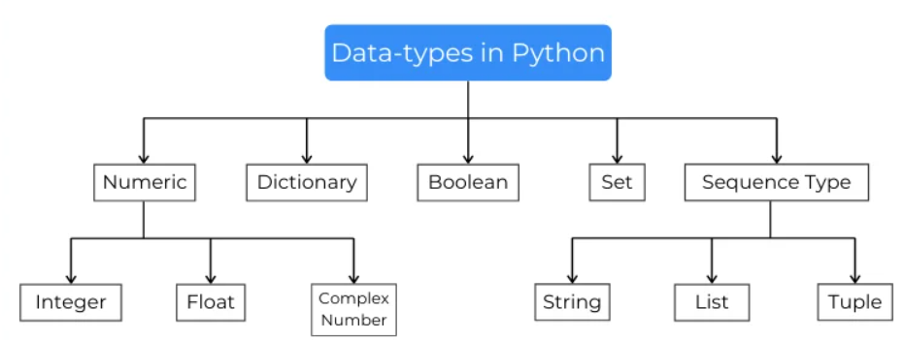
Datatypes In Python
Data types are the classification of data items. It represents that kind of value
You can get the data type of any object by using the type() function

